Slide 1















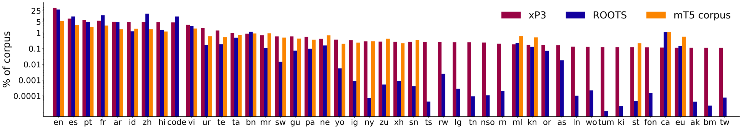
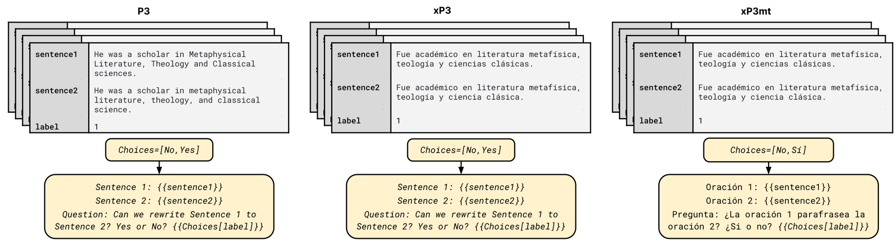
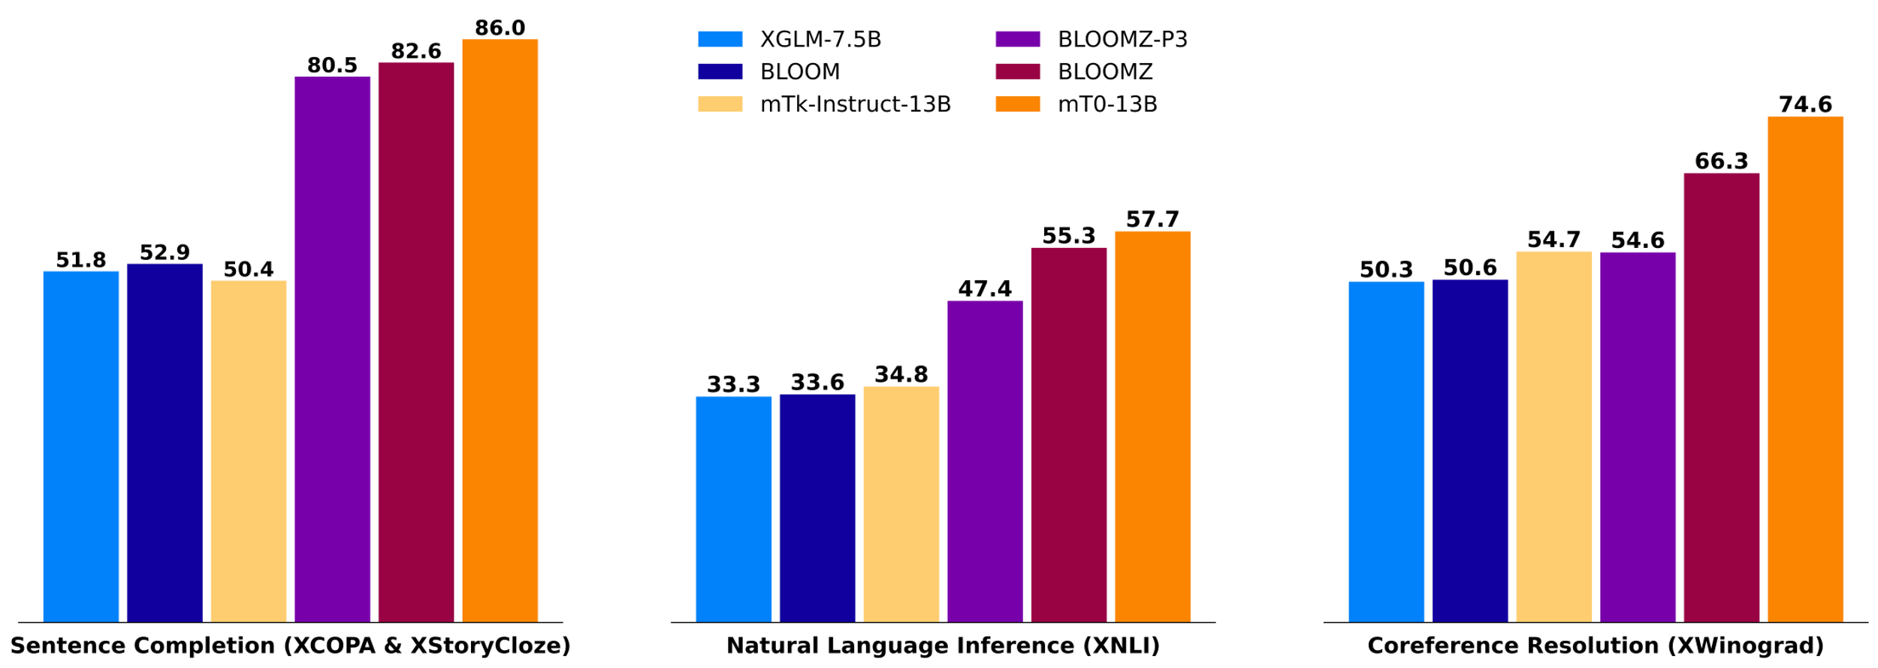
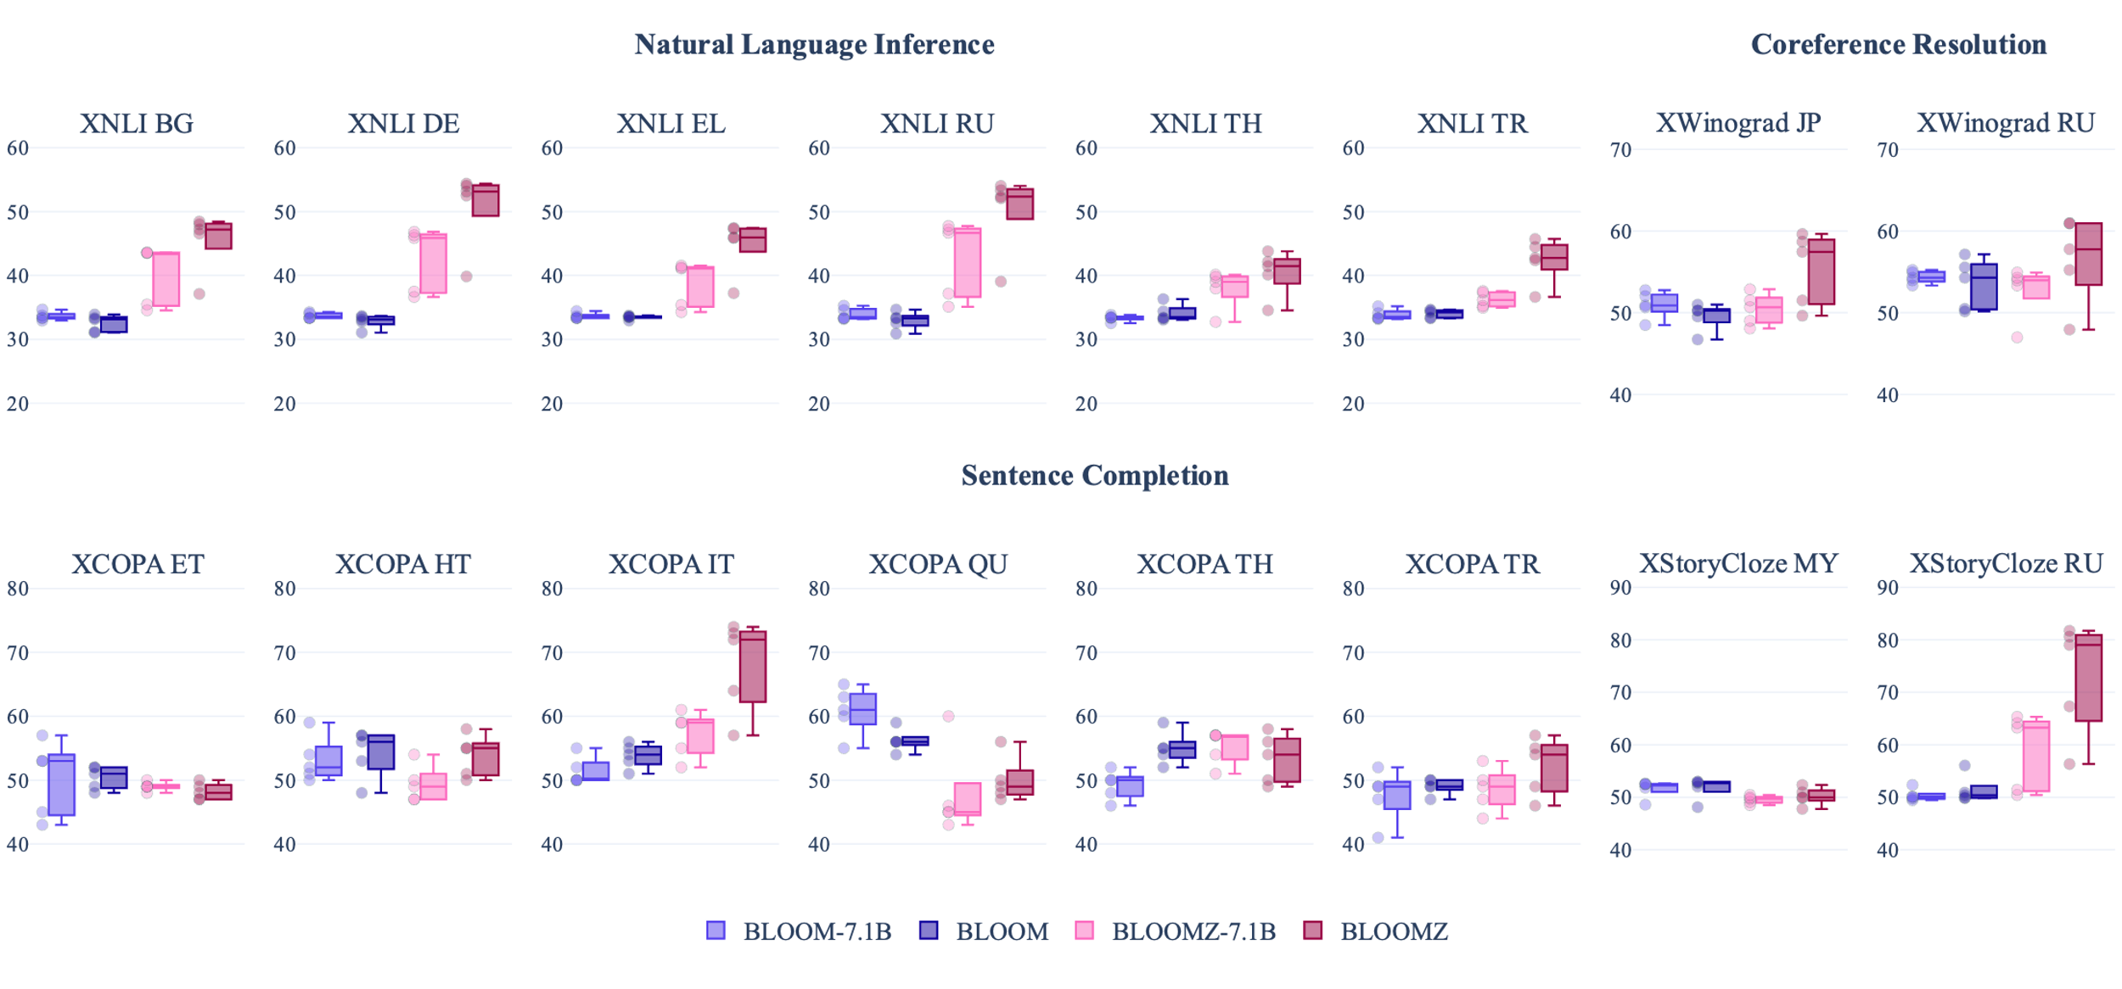
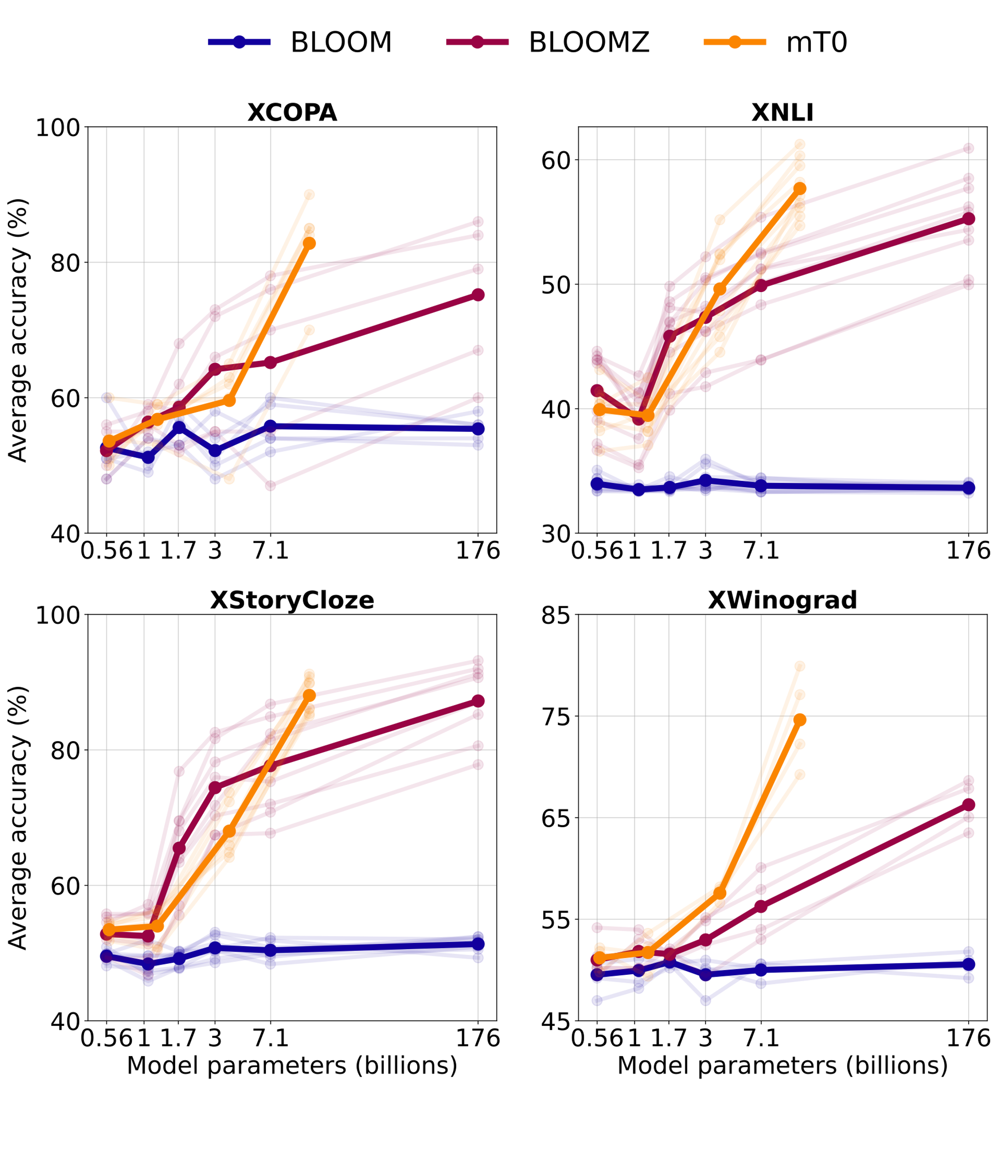
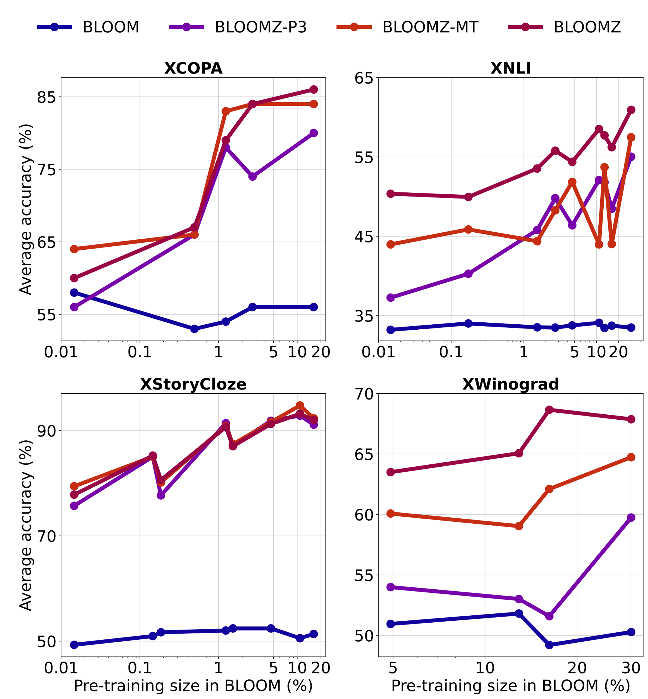
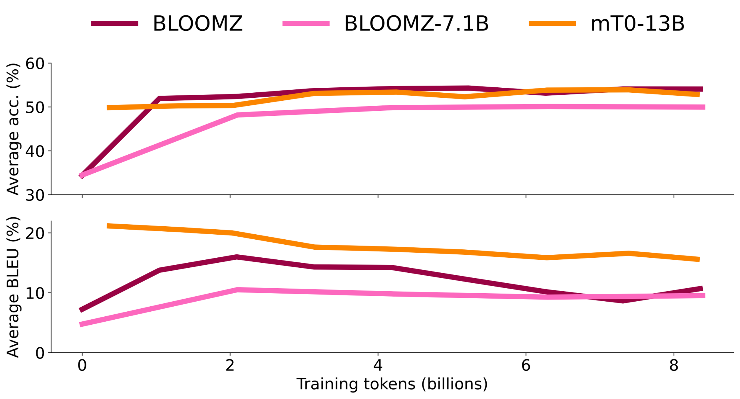
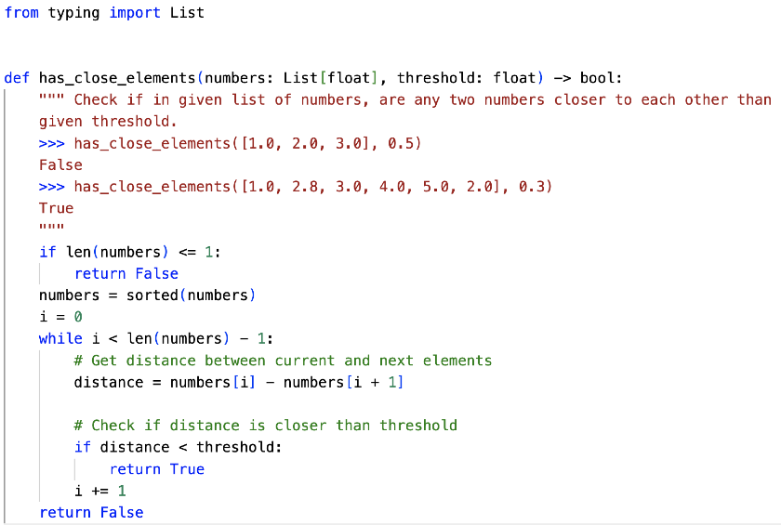
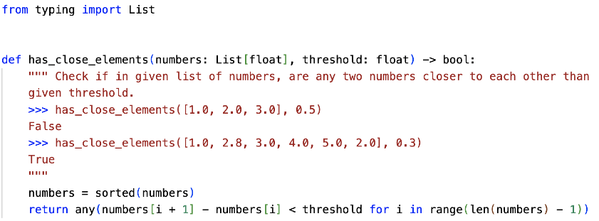
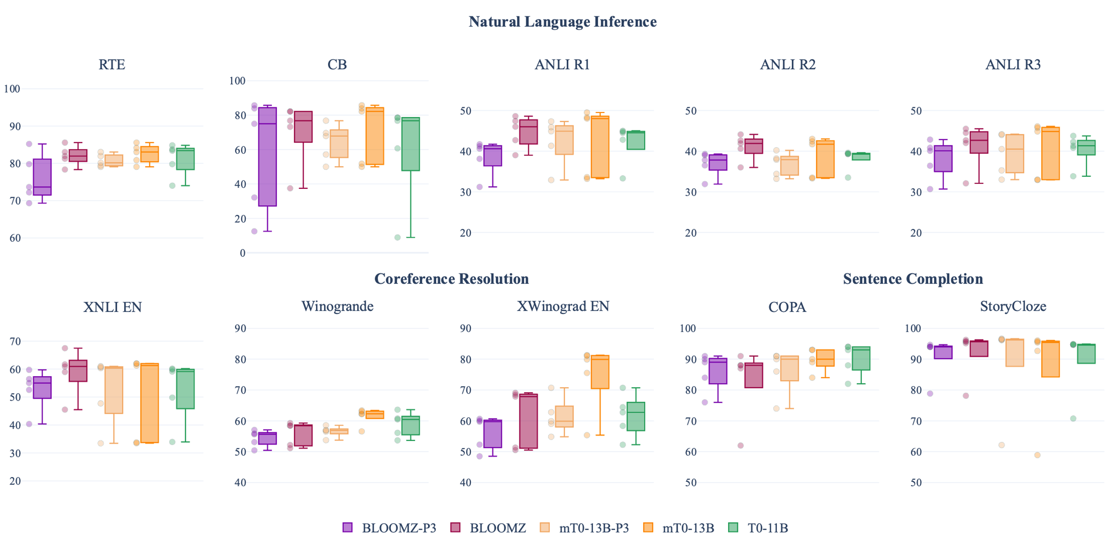
Crosslingual Generalization through Multitask Finetuning
Niklas Muennighoff, Thomas Wang, Lintang Sutawika, Adam Roberts, Stella Biderman, Teven Le Scao, M Saiful Bari,
Sheng Shen, Zheng-Xin Yong, Hailey Schoelkopf, Xiangru Tang, Dragomir Radev, Alham Fikri Aji,
Khalid Almubarak, Samuel Albanie, Zaid Alyafeai, Albert Webson, Edward Raff, Colin Raffel
PAPER
xP3: Crosslingual Corpus of prompted tasks in up to 277 languages
xP3 datasets & tasks divided into training (yellow) & evaluation (green)
xP3 language distribution
xP3 variants
xP3x (2023)
xP3 eXtension:
🌍 277 languages
🎡 700GB
🤯 500M samples
II. BLOOMZ & mT0: Instruction-tuned multilingual LLMs with up to 176B parameters
Generalization to unseen tasks
Generalization to unseen tasks in “unseen” languages
🇧🇬
🇩🇪
🇬🇷
🇷🇺
🇹🇭
🇹🇷
🇯🇵
🇷🇺
🇪🇪
🇭🇹
🇮🇹
🇵🇪
🇹🇭
🇹🇷
🇲🇲
🇷🇺
Scaling from 560M to 176B parameters
& importance of language distributions
unseen = not pretrained nor finetuned on
Generation
Generative performance degrades if fine-tuning too long! 💀
Code Generation on HumanEval 💻
BLOOM:
Training on xP3mt influences generation language 🇨🇳 🇬🇧 🇫🇷
BLOOMZ capable of creative writing following instructions, e.g. generating fables 👺
Models still display some failure modes like not clearly following instructions ⛔️
BLOOMZ:
mT0 beats T0 on English Tasks
BLOOMZ is biased towards short answers as most training examples are short ⚠️
➡️ Workaround:
Force minimum generation length💡

